Slide 1


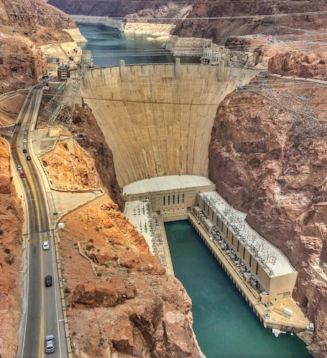
Civil Engineering
What do Civil Engineers Do?
Civil Engineers build and maintain infrastructure
This includes buildings, bridges, airports, and water systems
They make sure these systems are safe, stable, and work properly.
Civil Engineers are involved in transportation and urban development
The Hoover Dam

Slide 2

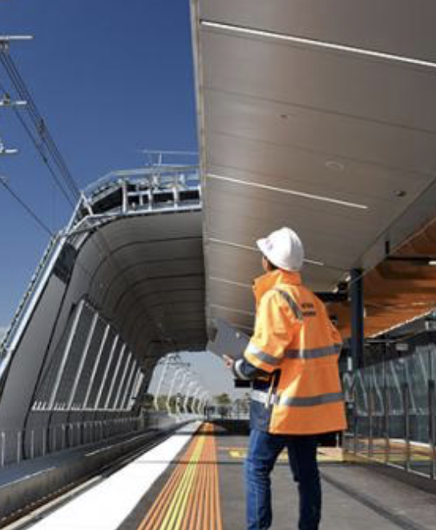
Civil Engineering
What do Civil Engineers Do?
Civil Engineers build and maintain infrastructure
This includes buildings, bridges, airports, and water systems
They make sure these systems are safe, stable, and work properly.
Civil Engineers are involved in transportation and urban development
The Hoover Dam
Civil Engineering Fields
Structural Engineer
Ensure buildings are stable and protected against natural disaster such as floods, winds, and earthquakes
Geotechnical Engineer
Soil experts that make sure mines, tunnels, and foundations are stable
Water Management Engineer
Studies meteorology (weather) and analysis flood/groundwater
Involved in water supply and wastewater treatment
Transportation Engineer
Works on transport projects such as railways, airports, and highways.

Slide 3
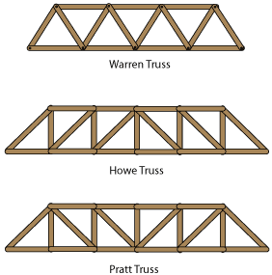
What do Civil Engineers Do?
Civil Engineers build and maintain infrastructure
This includes buildings, bridges, airports, and water systems
They make sure these systems are safe, stable, and work properly.
Civil Engineers are involved in transportation and urban development
The Hoover Dam
Civil Engineering Fields
Structural Engineer
Ensure buildings are stable and protected against natural disaster such as floods, winds, and earthquakes
Geotechnical Engineer
Soil experts that make sure mines, tunnels, and foundations are stable
Water Management Engineer
Studies meteorology (weather) and analysis flood/groundwater
Involved in water supply and wastewater treatment
Transportation Engineer
Works on transport projects such as railways, airports, and highways.
Popsicle Bridge Building!
Bridges will be judged based on the following:
Maximum Weight Supported
Bridge Weight to Weight Supported Ratio
Aesthetic appearance via popular vote
Materials List (Budget):
25-35 Popsicle Sticks
1 stick of hot glue (use your glue wisely!)
Bridge must span at least 12 inches
Groups of 3

Slide 4
Civil Engineering Fields
Structural Engineer
Ensure buildings are stable and protected against natural disaster such as floods, winds, and earthquakes
Geotechnical Engineer
Soil experts that make sure mines, tunnels, and foundations are stable
Water Management Engineer
Studies meteorology (weather) and analysis flood/groundwater
Involved in water supply and wastewater treatment
Transportation Engineer
Works on transport projects such as railways, airports, and highways.
Popsicle Bridge Building!
Bridges will be judged based on the following:
Maximum Weight Supported
Bridge Weight to Weight Supported Ratio
Aesthetic appearance via popular vote
Materials List (Budget):
25-35 Popsicle Sticks
1 stick of hot glue (use your glue wisely!)
Bridge must span at least 12 inches
Groups of 3
Key Lesson: Triangles
Triangle Family
Triangles are generally considered the strongest shape
This is because they are able to distribute their weight along three sides evenly
They are also the strongest because they are considered a rigid shape
Rigid shapes cannot change their shape or size without changing the lengths of their sides
This means three lines will always form the exact same triangle
Whereas four lines can be arranged into squares, rectangles, trapezoids, quadrilaterals, parallelograms, kites, rhombus, etc.
‘Square’ Family

Slide 5
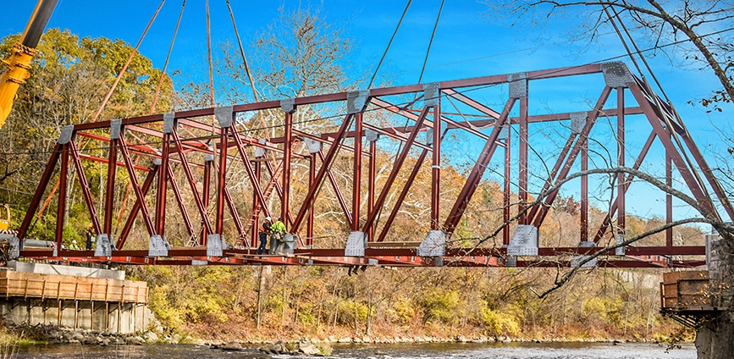
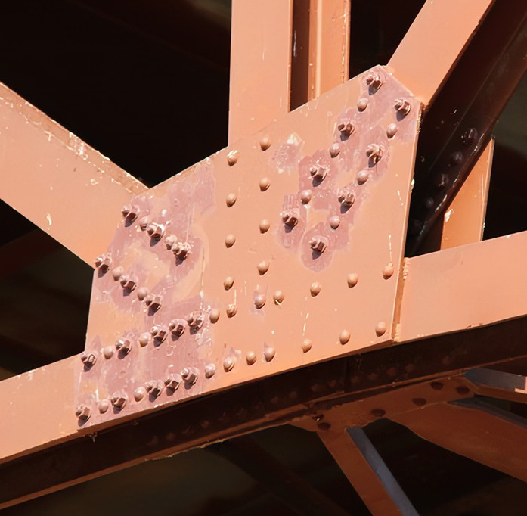
Popsicle Bridge Building!
Bridges will be judged based on the following:
Maximum Weight Supported
Bridge Weight to Weight Supported Ratio
Aesthetic appearance via popular vote
Materials List (Budget):
25-35 Popsicle Sticks
1 stick of hot glue (use your glue wisely!)
Bridge must span at least 12 inches
Groups of 3
Key Lesson: Triangles
Triangle Family
Triangles are generally considered the strongest shape
This is because they are able to distribute their weight along three sides evenly
They are also the strongest because they are considered a rigid shape
Rigid shapes cannot change their shape or size without changing the lengths of their sides
This means three lines will always form the exact same triangle
Whereas four lines can be arranged into squares, rectangles, trapezoids, quadrilaterals, parallelograms, kites, rhombus, etc.
‘Square’ Family
Key Lesson: Failure Analysis
Failure in Engineering basically refers to when a engineering component breaks
Failure point is the first component of a bridge that breaks as force/stress is applied.
Although Triangles are very strong, the linkages between Triangles could be prone to failure
This is why bridges reinforce their corners with many bolts.

Slide 6
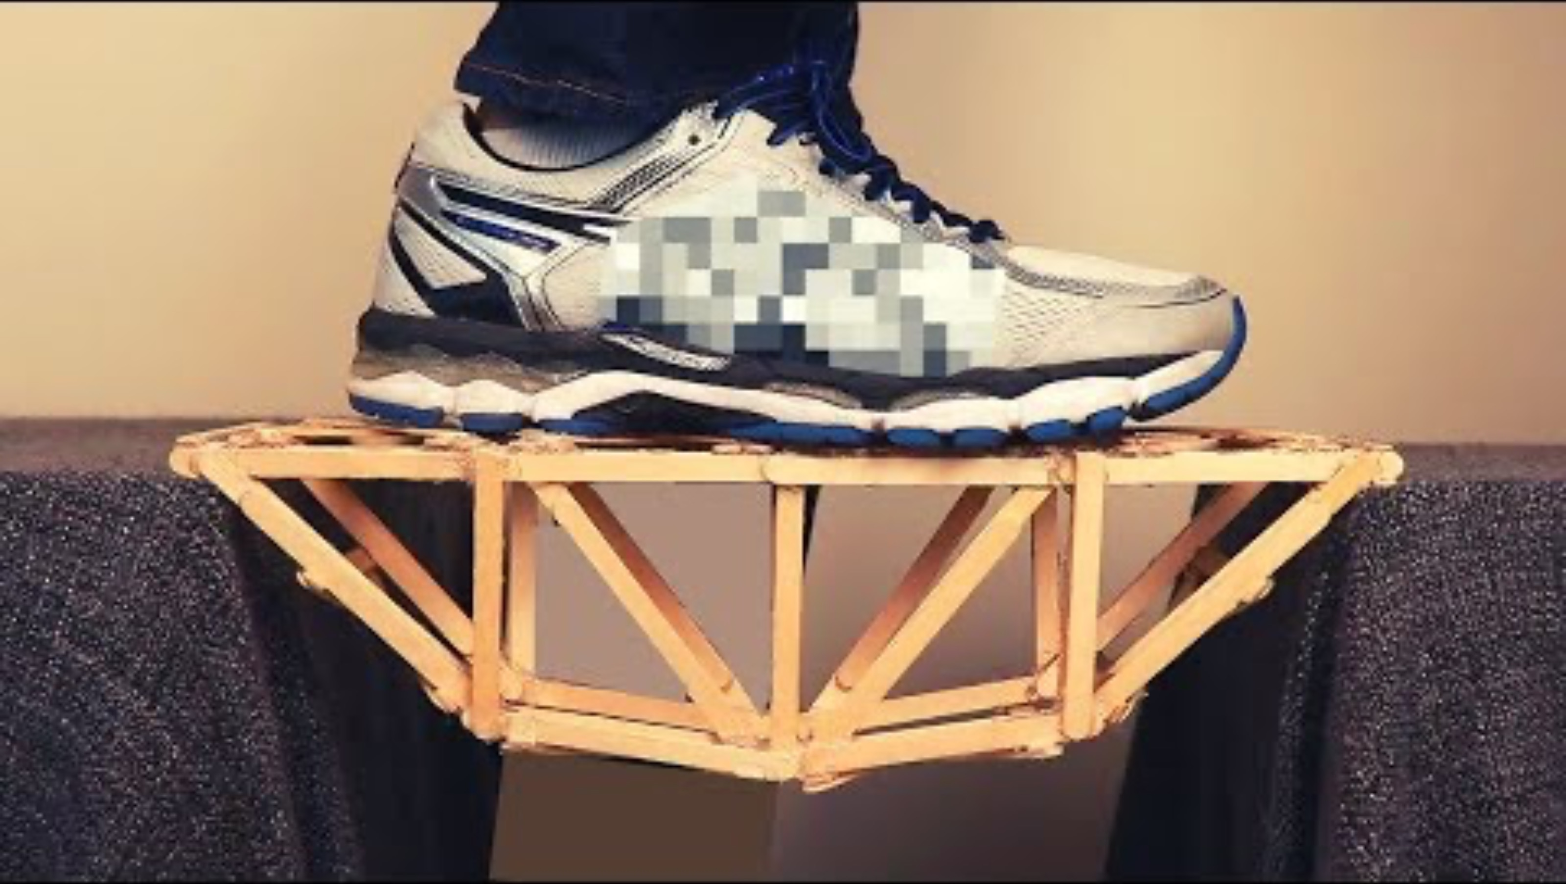
Key Lesson: Triangles
Triangle Family
Triangles are generally considered the strongest shape
This is because they are able to distribute their weight along three sides evenly
They are also the strongest because they are considered a rigid shape
Rigid shapes cannot change their shape or size without changing the lengths of their sides
This means three lines will always form the exact same triangle
Whereas four lines can be arranged into squares, rectangles, trapezoids, quadrilaterals, parallelograms, kites, rhombus, etc.
‘Square’ Family
Key Lesson: Failure Analysis
Failure in Engineering basically refers to when a engineering component breaks
Failure point is the first component of a bridge that breaks as force/stress is applied.
Although Triangles are very strong, the linkages between Triangles could be prone to failure
This is why bridges reinforce their corners with many bolts.
Application: Popsicle Bridges?
Exercise: Consider the two popsicle bridges below. Identify where the point of failure might be.

Slide 7
Key Lesson: Failure Analysis
Failure in Engineering basically refers to when a engineering component breaks
Failure point is the first component of a bridge that breaks as force/stress is applied.
Although Triangles are very strong, the linkages between Triangles could be prone to failure
This is why bridges reinforce their corners with many bolts.
Application: Popsicle Bridges?
Exercise: Consider the two popsicle bridges below. Identify where the point of failure might be.

